Slide 1
Cryptography and Network Security

Slide 2
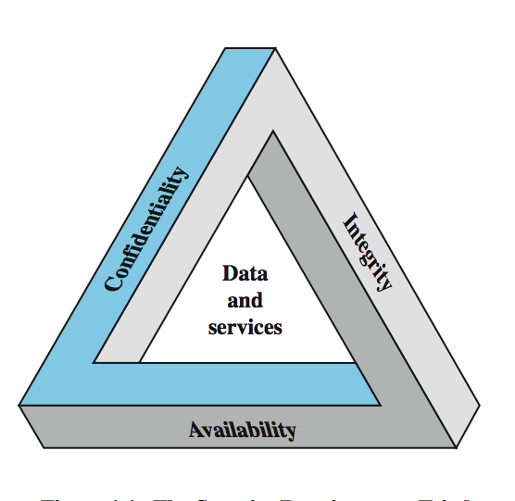
Key Security Concepts
Notes:
These three concepts form what is often referred to as the CIA triad (Figure 1.1). The three concepts embody the fundamental security objectives for both data and for information and computing services. FIPS PUB 199 provides a useful characterization of these three objectives in terms of requirements and the definition of a loss of security in each category:
• Confidentiality (covers both data confidentiality and privacy): preserving authorized restrictions on information access and disclosure, including means for protecting personal privacy and proprietary information. A loss of confidentiality is the unauthorized disclosure of information.
• Integrity (covers both data and system integrity): Guarding against improper information modification or destruction, and includes ensuring information non-repudiation and authenticity. A loss of integrity is the unauthorized modification or destruction of information.
• Availability: Ensuring timely and reliable access to and use of information. A loss of availability is the disruption of access to or use of information or an information system.
Although the use of the CIA triad to define security objectives is well established, some in the security field feel that additional concepts are needed to present a complete picture. Two of the most commonly mentioned are:
• Authenticity: The property of being genuine and being able to be verified and trusted; confidence in the validity of a transmission, a message, or message originator.
• Accountability: The security goal that generates the requirement for actions of an entity to be traced uniquely to that entity.

Slide 3
Aspects of Security
consider 3 aspects of information security:
security attack
security mechanism (control)
security service
note terms
threat – a potential for violation of security
vulnerability – a way by which loss can happen
attack – an assault on system security, a deliberate attempt to evade security services
Notes:
The OSI security architecture focuses on security attacks, mechanisms, and services. These can be defined briefly as follows:
• Security attack: Any action that compromises the security of information owned by an organization.
• Security mechanism: A process (or a device incorporating such a process) that is designed to detect, prevent, or recover from a security attack.
• Security service: A processing or communication service that enhances the security of the data processing systems and the information transfers of an organization. The services are intended to counter security attacks, and they make use of one or more security mechanisms to provide the service.
In the literature, the terms threat and attack are commonly used to mean more or less the same thing. Table 1.1 provides definitions taken from RFC 2828, Internet Security Glossary.
Threat - A potential for violation of security, which exists when there is a circumstance, capability, action, or event that could breach security and cause harm. That is, a threat is a possible danger that might exploit a vulnerability.
Attack - An assault on system security that derives from an intelligent threat; that is, an intelligent act that is a deliberate attempt (especially in the sense of a method or technique) to evade security services and violate the security policy of a system.

Slide 4
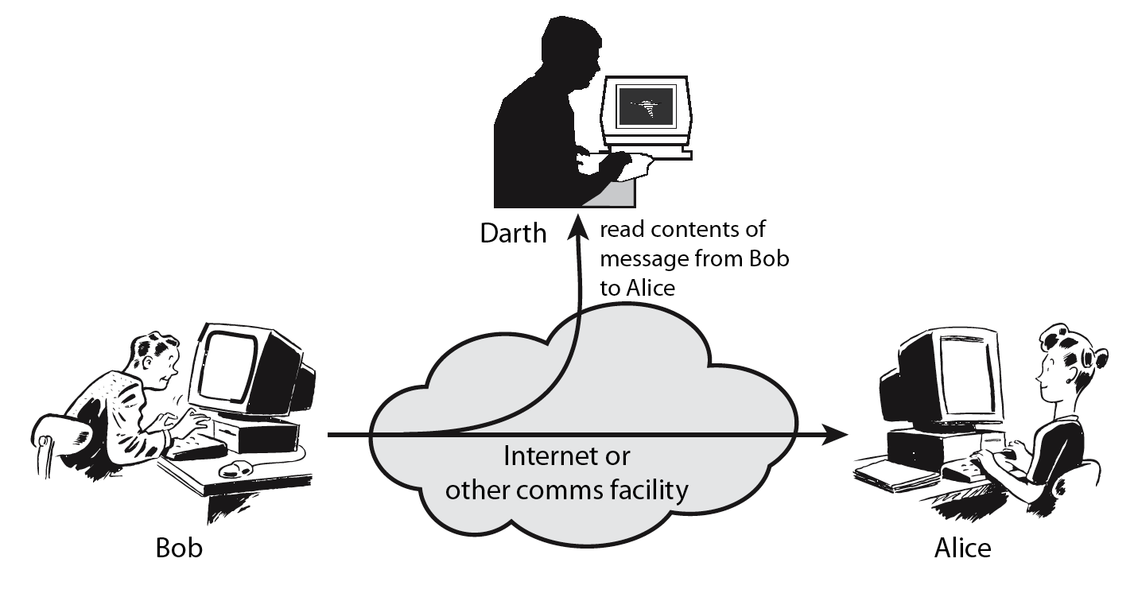
Passive Attack - Interception
Notes:
A useful means of classifying security attacks, used both in X.800 and RFC 2828, is in terms of passive attacks and active attacks. A passive attack attempts to learn or make use of information from the system but does not affect system resources.
Passive attacks are in the nature of eavesdropping on, or monitoring of, transmissions. The goal of the opponent is to obtain information that is being transmitted. Two types of passive attacks are:
+ release of message contents - as shown above in Stallings Figure 1.2a here
+ traffic analysis - monitor traffic flow to determine location and identity of communicating hosts and could observe the frequency and length of messages being exchanged
These attacks are difficult to detect because they do not involve any alteration of the data.

Slide 5
Passive Attack: Traffic Analysis
Observe traffic pattern
Notes:
A useful means of classifying security attacks, used both in X.800 and RFC 2828, is in terms of passive attacks and active attacks. A passive attack attempts to learn or make use of information from the system but does not affect system resources.
Passive attacks are in the nature of eavesdropping on, or monitoring of, transmissions. The goal of the opponent is to obtain information that is being transmitted. Two types of passive attacks are:
+ release of message contents - as shown above in Stallings Figure 1.2a here
+ traffic analysis - monitor traffic flow to determine location and identity of communicating hosts and could observe the frequency and length of messages being exchanged
These attacks are difficult to detect because they do not involve any alteration of the data.

Slide 6
Active Attack: Interruption
Block delivery of message
Notes:
A useful means of classifying security attacks, used both in X.800 and RFC 2828, is in terms of passive attacks and active attacks. A passive attack attempts to learn or make use of information from the system but does not affect system resources.
Passive attacks are in the nature of eavesdropping on, or monitoring of, transmissions. The goal of the opponent is to obtain information that is being transmitted. Two types of passive attacks are:
+ release of message contents - as shown above in Stallings Figure 1.2a here
+ traffic analysis - monitor traffic flow to determine location and identity of communicating hosts and could observe the frequency and length of messages being exchanged
These attacks are difficult to detect because they do not involve any alteration of the data.

Slide 7
Active Attack: Fabrication
Fabricate message
Notes:
A useful means of classifying security attacks, used both in X.800 and RFC 2828, is in terms of passive attacks and active attacks. A passive attack attempts to learn or make use of information from the system but does not affect system resources.
Passive attacks are in the nature of eavesdropping on, or monitoring of, transmissions. The goal of the opponent is to obtain information that is being transmitted. Two types of passive attacks are:
+ release of message contents - as shown above in Stallings Figure 1.2a here
+ traffic analysis - monitor traffic flow to determine location and identity of communicating hosts and could observe the frequency and length of messages being exchanged
These attacks are difficult to detect because they do not involve any alteration of the data.

Slide 8
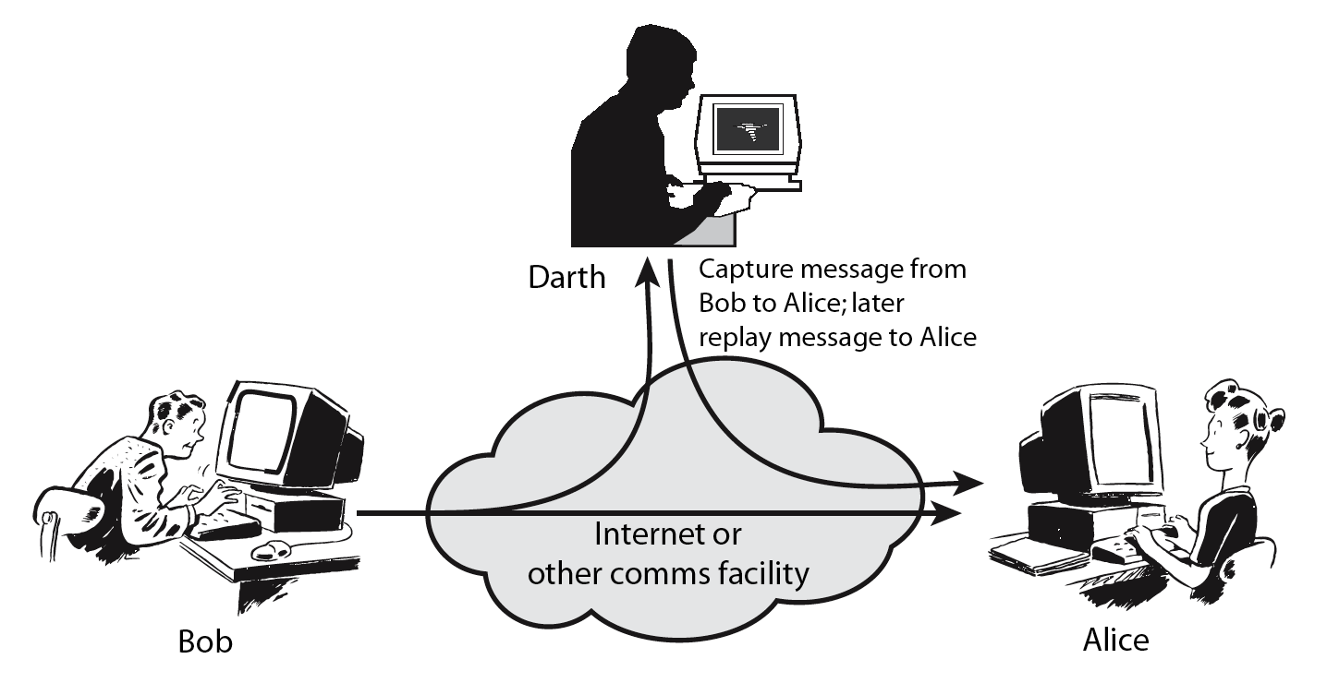
Active Attack: Replay
Notes:
Active attacks involve some modification of the data stream or the creation of a false stream and can be subdivided into four categories: masquerade, replay, modification of messages, and denial of service:
masquerade of one entity as some other
replay previous messages (as shown above in Stallings Figure 1.3b)
modify/alter (part of) messages in transit to produce an unauthorized effect
denial of service - prevents or inhibits the normal use or management of communications facilities
Active attacks present the opposite characteristics of passive attacks. Whereas passive attacks are difficult to detect, measures are available to prevent their success. On the other hand, it is quite difficult to prevent active attacks absolutely, because of the wide variety of potential physical, software, and network vulnerabilities. Instead, the goal is to detect active attacks and to recover from any disruption or delays caused by them.

Slide 9
Active Attack: Modification
Modify message
Notes:
Active attacks involve some modification of the data stream or the creation of a false stream and can be subdivided into four categories: masquerade, replay, modification of messages, and denial of service:
masquerade of one entity as some other
replay previous messages (as shown above in Stallings Figure 1.3b)
modify/alter (part of) messages in transit to produce an unauthorized effect
denial of service - prevents or inhibits the normal use or management of communications facilities
Active attacks present the opposite characteristics of passive attacks. Whereas passive attacks are difficult to detect, measures are available to prevent their success. On the other hand, it is quite difficult to prevent active attacks absolutely, because of the wide variety of potential physical, software, and network vulnerabilities. Instead, the goal is to detect active attacks and to recover from any disruption or delays caused by them.

Slide 10
Symmetric Encryption
or conventional / private-key / single-key
sender and recipient share a common key
all classical encryption algorithms are private-key
was only type prior to invention of public-key in 1970’s
Notes:
All traditional schemes are symmetric / single key / private-key encryption algorithms, with a single key, used for both encryption and decryption, since both sender and receiver are equivalent, either can encrypt or decrypt messages using that common key.

Slide 11
Basic Terminology
plaintext - the original message
ciphertext - the coded message
cipher - algorithm for transforming plaintext to ciphertext
key - info used in cipher known only to sender/receiver
encipher (encrypt) - converting plaintext to ciphertext
decipher (decrypt) - recovering ciphertext from plaintext
cryptography - study of encryption principles/methods
cryptanalysis (codebreaking) - the study of principles/ methods of deciphering ciphertext without knowing key
cryptology - the field of both cryptography and cryptanalysis
Notes:
Briefly review some terminology used throughout the course.

Slide 12
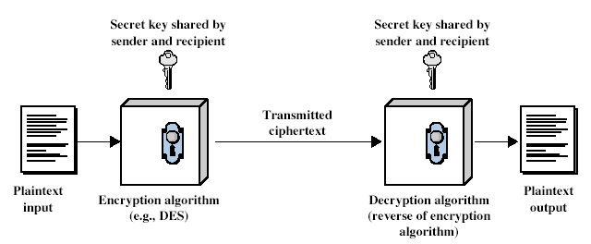
Symmetric Cipher Model
Notes:
Detail 5 ingredients of the symmetric cipher model:
plaintext
encryption algorithm – performs substitutions/transformations on plaintext
secret key – control exact substitutions/transformations used in encryption algorithm
ciphertext
decryption algorithm – inverse of encryption algorithm

Slide 13
Requirements
two requirements for secure use of symmetric encryption:
a strong encryption algorithm
a secret key known only to sender / receiver
Y = E_{K}(X)
X = D_{K}(Y)
assume encryption algorithm is known
implies a secure channel to distribute key
Notes:
Generally assume that the algorithm is known.
This allows easy distribution of s/w and h/w implementations.
Hence assume just keeping key secret is sufficient to secure encrypted messages.
Have plaintext X, ciphertext Y, key K, encryption alg Ek, decryption alg Dk.

Slide 14
Cryptography
can characterize by:
type of encryption operations used
substitution / transposition / product
number of keys used
single-key or private / two-key or public
way in which plaintext is processed
block / stream

Slide 15
Types of Cryptanalytic Attacks
ciphertext only
only know algorithm / ciphertext, statistical, can identify plaintext
known plaintext
know/suspect plaintext & ciphertext to attack cipher
chosen plaintext
select plaintext and obtain ciphertext to attack cipher
chosen ciphertext
select ciphertext and obtain plaintext to attack cipher
chosen text
select either plaintext or ciphertext to en/decrypt to attack cipher

Slide 16
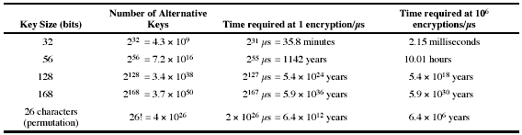
Brute Force Search
always possible to simply try every key
most basic attack, proportional to key size
assume either know / recognise plaintext

Slide 17
More Definitions
unconditional security
no matter how much computer power is available, the cipher cannot be broken since the ciphertext provides insufficient information to uniquely determine the corresponding plaintext
computational security
given limited computing resources (eg time needed for calculations is greater than age of universe), the cipher cannot be broken
Notes:
Unconditional security would be nice, but the only known such cipher is the one-time pad (later). For all reasonable encryption algorithms, have to assume computational security where it either takes too long, or is too expensive, to bother breaking the cipher.

Slide 18
Classical Substitution Ciphers
where letters of plaintext are replaced by other letters or by numbers or symbols
or if plaintext is viewed as a sequence of bits, then substitution involves replacing plaintext bit patterns with ciphertext bit patterns
Notes:
In this section and the next, we examine a sampling of what might be called classical encryption
techniques. A study of these techniques enables us to illustrate the basic approaches to
symmetric encryption used today and the types of cryptanalytic attacks that must be anticipated.
The two basic building blocks of all encryption techniques: substitution and transposition.
We examine these in the next two sections. Finally, we discuss a system that combine both
substitution and transposition.

Slide 19
Caesar Cipher
earliest known substitution cipher
by Julius Caesar
first attested use in military affairs
replaces each letter by 3rd letter on
example:
meet me after the toga party
PHHW PH DIWHU WKH WRJD SDUWB
Notes:
Substitution ciphers form the first of the fundamental building blocks. The core idea is to replace one basic unit (letter/byte) with another. Whilst the early Greeks described several substitution ciphers, the first attested use in military affairs of one was by Julius Caesar, described by him in Gallic Wars (cf. Kahn pp83-84). Still call any cipher using a simple letter shift a caesar cipher, not just those with shift 3.
Note: when letters are involved, the following conventions are used in this course: Plaintext is always in lowercase; ciphertext is in uppercase; key values are in italicized lowercase.

Slide 20
Caesar Cipher
can define transformation as:
a b c d e f g h i j k l m n o p q r s t u v w x y z
D E F G H I J K L M N O P Q R S T U V W X Y Z A B C
mathematically give each letter a number
a b c d e f g h i j k l m
0 1 2 3 4 5 6 7 8 9 10 11 12
n o p q r s t u v w x y Z
13 14 15 16 17 18 19 20 21 22 23 24 25
then have Caesar cipher as:
C = E(p) = (p + k) mod (26)
p = D(C) = (C – k) mod (26)
Notes:
This mathematical description uses modulo arithmetic (ie clock arithmetic). Here, when you reach Z you go back to A and start again. Mod 26 implies that when you reach 26, you use 0 instead (ie the letter after Z, or 25 + 1 goes to A or 0).
Example: howdy (7,14,22,3,24) encrypted using key f (5) is MTBID

Slide 21
Cryptanalysis of Caesar Cipher
only have 26 possible ciphers
A maps to A,B,..Z
could simply try each in turn
a brute force search
given ciphertext, just try all shifts of letters
do need to recognize when have plaintext
eg. break ciphertext "GCUA VQ DTGCM"
Notes:
With a caesar cipher, there are only 26 possible keys, of which only 25 are of any use, since mapping A to A etc doesn't really obscure the message! cf. basic rule of cryptanalysis "check to ensure the cipher operator hasn't goofed and sent a plaintext message by mistake"!
Can try each of the keys (shifts) in turn, until can recognise the original message. See Stallings Fig 2.3 for example of search.
Note: as mentioned before, do need to be able to recognise when have an original message (ie is it English or whatever). Usually easy for humans, hard for computers. Though if using say compressed data could be much harder.
Example "GCUA VQ DTGCM" when broken gives "easy to break", with a shift of 2 (key C).

Slide 22
Monoalphabetic Cipher
rather than just shifting the alphabet
could shuffle (jumble) the letters arbitrarily
each plaintext letter maps to a different random ciphertext letter
hence key is 26 letters long
Plain: abcdefghijklmnopqrstuvwxyz
Cipher: DKVQFIBJWPESCXHTMYAUOLRGZN
Plaintext: ifwewishtoreplaceletters
Ciphertext: WIRFRWAJUHYFTSDVFSFUUFYA

Slide 23
Monoalphabetic Cipher Security
now have a total of 26! keys
with so many keys, might think is secure
but would be !!!WRONG!!!
problem is language characteristics

Slide 24
Language Redundancy and Cryptanalysis
human languages are redundant
eg "th lrd s m shphrd shll nt wnt"
letters are not equally commonly used
in English e is by far the most common letter
then T,R,N,I,O,A,S
other letters are fairly rare
cf. Z,J,K,Q,X
have tables of single, double & triple letter frequencies
Notes:
As the example shows, we don't actually need all the letters in order to understand written English text. Here vowels were removed, but they're not the only redundancy. cf written Hebrew has no vowels for same reason. Are usually familiar with "party conversations", can hear one person speaking out of hubbub of many, again because of redundancy in aural language also. This redundancy is also the reason we can compress text files, the computer can derive a more compact encoding without losing any information. Basic idea is to count the relative frequencies of letters, and note the resulting pattern.

Slide 25
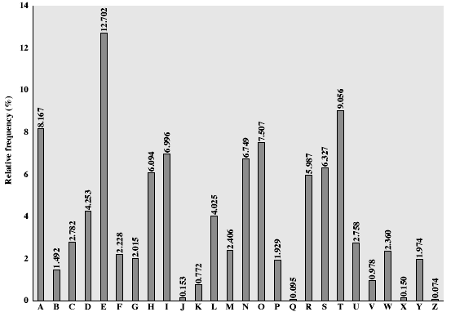
English Letter Frequencies
Notes:
This graph is based on counts done at ADFA in the late 1980's, and used to develop the tables published in Seberry & Pieprzyk [SEBE89].
Note that all human languages have varying letter frequencies, though the number of letters and their frequencies varies.
Seberry & Pieprzyk [SEBE89] Appendix A has graphs for 20 languages (most European & Japanese & Malay).

Slide 26
Use in Cryptanalysis
key concept - monoalphabetic substitution ciphers do not change relative letter frequencies
discovered by Arabian scientists in 9th century
calculate letter frequencies for ciphertext
compare counts/plots against known values
if Caesar cipher look for common peaks/troughs
peaks at: A-E-I triple, NO pair, RST triple
troughs at: JK, X-Z
for monoalphabetic must identify each letter
tables of common double/triple letters help
Notes:
The simplicity and strength of the monoalphabetic substitution cipher meant it dominated cryptographic use for the first millenium AD. It was broken by Arabic scientists. The earliest known description is in Abu al-Kindi's "A Manuscript on Deciphering Cryptographic Messages", published in the 9th century but only rediscovered in 1987 in Istanbul, but other later works also attest to their knowledge of the field.

Slide 27
Example Cryptanalysis
given ciphertext:
UZQSOVUOHXMOPVGPOZPEVSGZWSZOPFPESXUDBMETSXAIZ
VUEPHZHMDZSHZOWSFPAPPDTSVPQUZWYMXUZUHSX
EPYEPOPDZSZUFPOMBZWPFUPZHMDJUDTMOHMQ
count relative letter frequencies (see text)
guess P & Z are e and t
guess ZW is th and hence ZWP is the
proceeding with trial and error fially get:
it was disclosed yesterday that several informal but
direct contacts have been made with political
representatives of the viet cong in moscow

Slide 28
Polyalphabetic Ciphers
another approach to improving security is to use multiple cipher alphabets
called polyalphabetic substitution ciphers
makes cryptanalysis harder with more alphabets to guess and flatter frequency distribution
use a key to select which alphabet is used for each letter of the message
use each alphabet in turn
repeat from start after end of key is reached
Notes:
One approach to reducing the "spikyness" of natural language text is used the Playfair cipher which encrypts more than one letter at once. We now consider the other alternative, using multiple cipher alphabets in turn. This gives the attacker more work, since many alphabets need to be guessed, and because the frequency distribution is more complex, since the same plaintext letter could be replaced by several ciphertext letters, depending on which alphabet is used.

Slide 29
Vigenère Cipher
simplest polyalphabetic substitution cipher is the Vigenère Cipher
effectively multiple caesar ciphers
key is multiple letters long K = k1 k2 ... kd
i^{th} letter specifies i^{th} alphabet to use
use each alphabet in turn
repeat from start after d letters in message
decryption simply works in reverse
Notes:
Simply create a set of caesar cipher translation alphabets, then use each in turn, as shown next.

Slide 30
Example
write the plaintext out
write the keyword repeated above it
use each key letter as a caesar cipher key
encrypt the corresponding plaintext letter
eg using keyword deceptive
key: deceptivedeceptivedeceptive
plaintext: wearediscoveredsaveyourself
ciphertext:ZICVTWQNGRZGVTWAVZHCQYGLMGJ

Slide 31
One-Time Pad
if a truly random key as long as the message is used, the cipher will be secure
called a One-Time pad
is unbreakable since ciphertext bears no statistical relationship to the plaintext
since for any plaintext & any ciphertext there exists a key mapping one to other
can only use the key once though
have problem of safe distribution of key
Notes:
The One-Time Pad is an evolution of the Vernham cipher, which was invented by Gilbert Vernham in 1918, and used a long tape of random letters to encrypt the message. An Army Signal Corp officer, Joseph Mauborgne, proposed an improvement using a random key that was truly as long as the message, with no repetitions, which thus totally obscures the original message.
Since any plaintext can be mapped to any ciphertext given some key, there is simply no way to determine which plaintext corresponds to a specific instance of ciphertext.

Slide 32
Transposition Ciphers
now consider classical transposition or permutation ciphers
these hide the message by rearranging the letter order
without altering the actual letters used
can recognise these since have the same frequency distribution as the original text
Notes:
Transposition Ciphers form the second basic building block of ciphers. The core idea is to rearrange the order of basic units (letters/bytes/bits) without altering their actual values.

Slide 33
Row Transposition Ciphers
a more complex scheme
write letters of message out in rows over a specified number of columns
then reorder the columns according to some key before reading off the rows
Key: 4 3 1 2 5 6 7
Plaintext: a t t a c k p
o s t p o n e
d u n t i l t
w o a m x y z
Ciphertext: TTNAAPTMTSUOAODWCOIXKNLYPETZ

Slide 34
Product Ciphers
ciphers using substitutions or transpositions are not secure because of language characteristics
hence consider using several ciphers in succession to make harder, but:
two substitutions make a more complex substitution
two transpositions make more complex transposition
but a substitution followed by a transposition makes a new much harder cipher
this is bridge from classical to modern ciphers

